Slide 1
Odoo Upgrade - Progress Reporting
August [09 to 13]

Slide 2

Overview

Slide 3
Overview
Project Documents and References:
Project Plan link:
https://docs.google.com/spreadsheets/d/18ZDAdHBzsEPdpr6rOwJDw2ViElgeVGW-ovWh-N8FheQ/edit?usp=sharing
Functional Test cases document:
https://docs.google.com/spreadsheets/d/12t1AjhoWo4CEOnC9snuApc7Y9-KMogo06I3qzkV-VHQ/edit?usp=sharing
UAT and Complete QA planning:
https://docs.google.com/spreadsheets/d/1zogqMJEMYcj1Ipb8xfOZKy1jcYYzcgeYiMnl-DUolIM/edit?usp=sharing

Slide 4
Progress Report -Aug [09 - 13]

Slide 5
Progress Report Summary - Aug [02 to 06]
Week Highlights: [August 09-13]
Modules Migration [By Verts Team]
Saarus:
Code migration is complete and shared with KOKO team.
KNK:
Finance feature demonstration started and it will continue for next week.
Data Migration [By Verts Team]
Saarus:
Data migration is completed and updated DB link is shared to KOKO team.
Next Week Plan and Highlights: [August 13-16]
Modules Migration [By Verts Team]
Saarus:
Code review and PR is in progress
Test server set up and configuration is planned
Testing to start y KOKO QA.
KNK:
Demo features to continue
Non finance modules completion is expected.

Slide 6
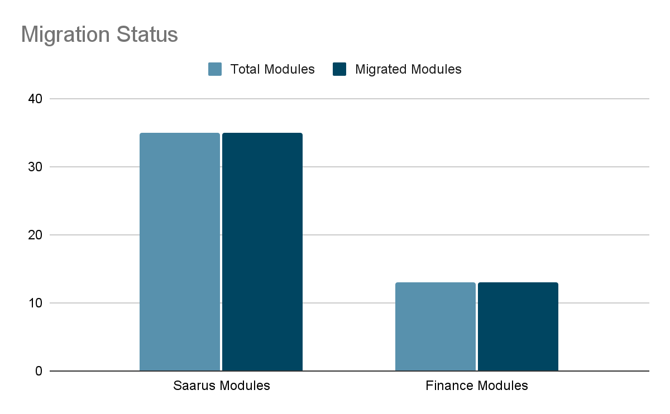
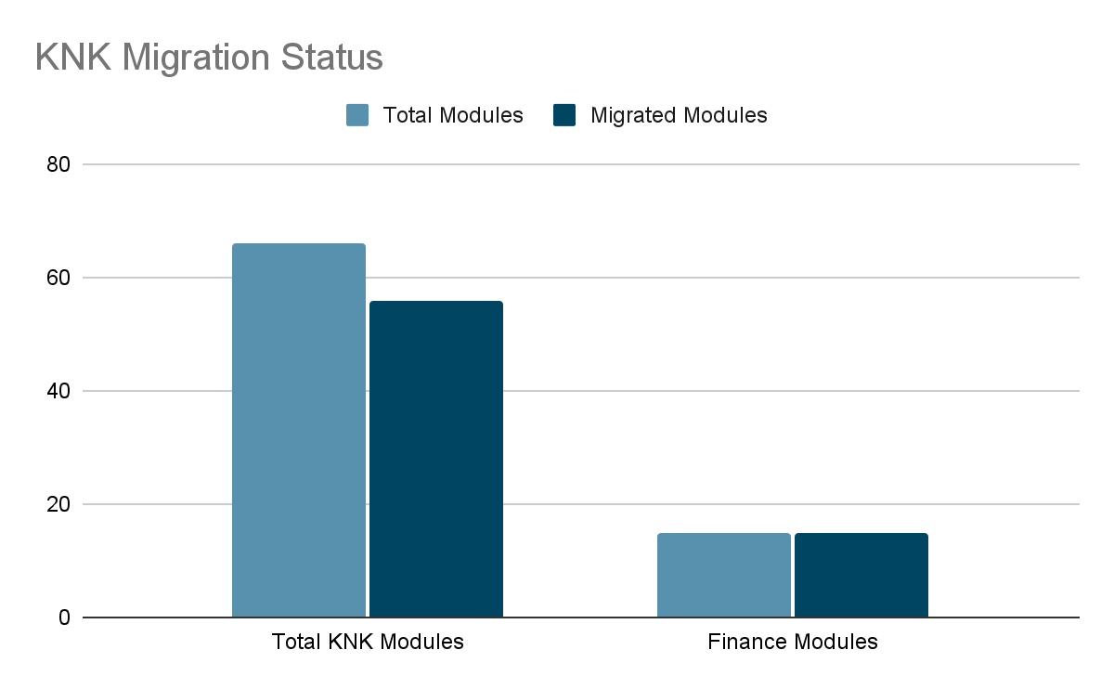
Progress Analysis
Saarus Code Migration Status
KNK Code Migration Status

Slide 7
Risks and Issue
Not identified

Slide 8
Madhav Agarwal / Siddique Momin
m.agarwal@kokonetworks.com, s.momin@kokonetworks.com

